Slide 1
LegalEase(App For Onboarding Legal Services)
CSE7101- Capstone Project
Review-3
Batch Number: CSE_160
Under the Supervision of,
Mr. Thatimakula Saikumar – Assistant Professor
Ms. Saiqa Khan - Assistant Professor
School of Computer Science and Engineering
Presidency University
Roll Number | Student Name
20221CSE0090 20221CSE0195 20221CSE0225 | Vishnu. P Vasista. S Dhanush. A
Name of the Program: Computer Science and Engineering
Name of the HoD: Dr.Asif Mohammed , Dr.Blessed Prince
Name of the Program Project Coordinator: Dr.Jayavadivel Ravi , Mr.Muthuraju V
Name of the School Project Coordinators: Dr. Sampath A K , Dr. Geetha A

Slide 2
Content
Github link
Abstract
Literature Survey
Objectives
Existing methods & Drawbacks
Proposed method & Feasibility study
Architecture Diagram
Modules
Timeline of the Project
References

Slide 3
Problem Statement Number: PSCS-39
Git-hub Link : https://github.com/vishnu090705/Onboarding-legal-service-providers.git
Category : Software
Abstract :
This project develops a secure Android application for onboarding Legal Service Providers using e-KYC verification to ensure authenticity and trust. Existing portals fail to provide simplified, accessible, and timely updates, resulting in missed opportunities.
An incentive-based gamification model encourages professional participation, while citizens gain transparent access to verified legal services through a reliable digital marketplace.
The expected outcome is a transparent, secure, and user-friendly eMarketplace that enhances citizen trust, improves access to legal services, and ensures better engagement of professionals. The project also offers real-world exposure to full-stack mobile development, authentication systems, and incentive-based platform design.

Slide 4
Literature Survey
[10] Nyaya Shastra: E-Platform for Legal Providers," IJARSCT, 2024
Link: https://ijarsct.co.in/Paper25646.pdf
[12] Karnale, P.R., Chavan, S.R., Chougale, A.B., Patil, A.A., Jamadar, S.S. (2023), "Incentives based Design for onboarding Legal Service Providers for Extending Legal Services.“
Link: https://www.scribd.com/document/711640084/Incentives-based-Design-for-onboarding-Legal-Service-Providers-for-extending-Legal-Services-to-Citizens-in-India-1
[15]LEGAL SAHYOG HUB: JETIR2406832, "Incentives Based Design For Onboarding Legal Service Providers.”
Link: https://www.jetir.org/view?paper=JETIR2406832
[18]Legal Bharat Incentive, Legalbharat
Link : https://www.scribd.com/document/875148548/Legal-Bharat-Incentive

Slide 5
Objectives
Develop a secure Android application that enables Legal Service Providers (LSPs) such as advocates, notaries, and mediators to onboard digitally with proper authentication.
Integrate e-KYC verification mechanisms (Aadhaar OTP, document OCR scanning, and face recognition) to ensure trust, authenticity, and fraud prevention.
Design and implement an incentive-based system (badges, rewards, rankings) that motivates legal professionals to actively participate and maintain service quality.
Provide citizens with a user-friendly interface to search, filter, and connect with verified legal service providers, while allowing admins to monitor onboarding and approvals.

Slide 6
Existing methods & Drawbacks
Offline registrations are manual, slow, and lack transparency.
Government initiatives mainly focus on case management and not professional onboarding.
Lack of trust & authenticity in current legal service listings.
No incentives to encourage active participation from professionals.
Poor user experience for citizens in discovering verified providers.
Manual/limited verification leading to fraud or fake entries.

Slide 7
Proposed method & Feasibility study
Proposed Method:
The proposed solution is the “LegalEase" Progressive App. Its innovation lies in its integrated, accessible, and user-centric design:
Secure Onboarding via e-KYCIntegration of Aadhaar OTP-based e-KYC to verify identity.
Incentive-Based Engagement System Gamification features such as badges, points, and rankings to motivate professionals.
Incentive-Based Engagement System Gamification features such as badges, points, and rankings to motivate professionals.
Feasibility Study:
Technical Feasibility: The system can be implemented using widely available technologies like Android Studio (Java) for mobile development, Firebase/AWS for secure storage, and UIDAI e-KYC / OCR / Face Recognition APIs for verification.
Economic Feasibility: Deployment on cloud services can be scaled as needed, ensuring cost-effectiveness for prototype and real-world usage.

Slide 8
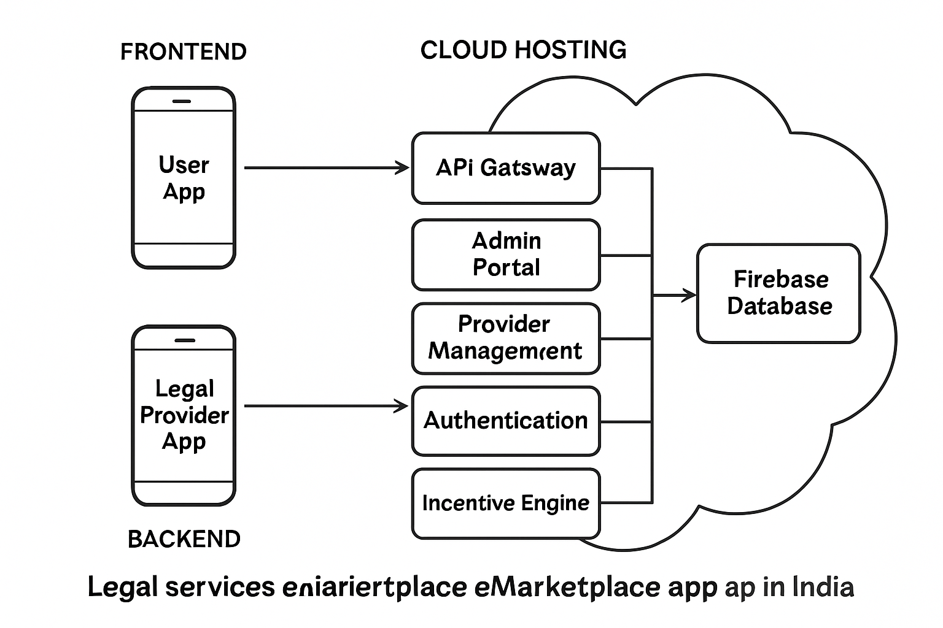
Architecture Diagram

Slide 9
Architecture Diagram continue…….
Frontend:
The frontend is composed of mobile applications for both citizens and legal service providers, offering intuitive interfaces for searching legal experts, booking consultations.
The mobile apps focus on ease of use, accessibility, and real-time interaction with backend services to provide responsive and seamless user experiences.
Backend
The backend provides essential services including API gateways for client-server communication, provider verification and management, secure authentication, feedback and rating systems.
Backend modules communicate with the frontend and database layers, facilitating data exchange, processing booking requests, and enforcing security protocols.
Key Components:
Authentication Service: Manages user logins.
E-KYC verification : Verifying the legal providers by Aadhaar number and bar council number.
Cloud Hosting: The entire application is deployed on a cloud provider for reliability and scalability.

Slide 10
Modules
User Authentication Module: Handles registration and login of Legal Service Providers (LSPs), citizens, and admins.
e-KYC Verification Module : Cross-verifies uploaded documents with user-entered details. Ensures onboarding of only genuine and verified LSPs.
Incentive & Gamification Module : Provides rewards such as badges, points, certificates, and higher visibility for verified LSPs.
Citizen Service Access Module : Enables citizens to search, filter, and view verified LSP profiles.
Cloud Storage & API Module : Uses Firebase Storage / AWS S3 to store documents.

Slide 11
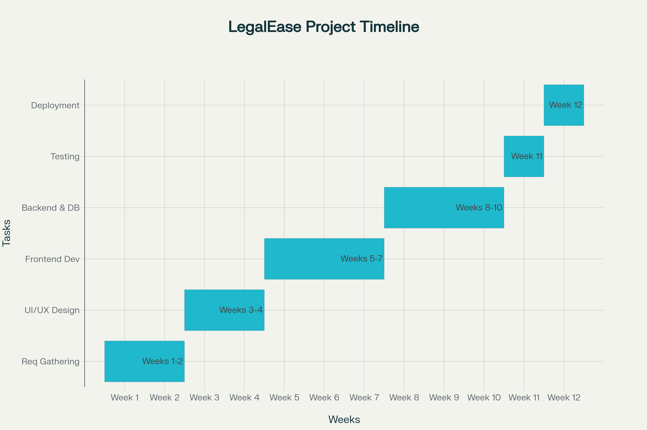
Timeline

Slide 12
References
[1]. [Sharetribe], "How to build a marketplace for legal services," 2023.sharetribe
[2]. Itexus, "Legal Marketplace Development: Guide," 2023.itexus
[3]. "LegalTech in India – Role of Technology and Legal Education," Taxmann, 2025.taxmann
[4]. Infosys, "How a Digital Transformation Enhances the Extended Legal ...," Infosys.com, 2024.infosys
[5]. "Alternative legal service providers muscle in," Law.asia, 2025.
[6]. "Top 11 ODR Service Providers in India," Online Legal India, 2025.onlinelegalindia
[7]. Indian Journal of Law and Technology (IJLT), Vol. 20, Issue 1 (2022).
[8]."Impact of Digital Legal Services on Traditional Law Practice in India," ICISIT,2024.iciset
[9]. "Startups as disruptors of legal tech in India," Daksh, 2020.dakshindia
[10]. "Nyaya Shastra: E-Platform for Legal Providers," IJARSCT, 2024.ijarsct
[11]. Legal Kart, "The Rise of Online Lawyer Consultation," LegalKart.com, 2025.

Slide 13
References continue…
[12]. Karnale, P.R., Chavan, S.R., Chougale, A.B., Patil, A.A., Jamadar, S.S. (2023), "Incentives based Design for onboarding Legal Service Providers in India," IJSREM.scribd
[13]. "Legal Tech Startups in India," PrivateCircle, 2025.
[14]. "Online Dispute Resolution Service Providers in India," 2025.
[15]. LEGAL SAHYOG HUB: JETIR2406832, "Incentives Based Design For Onboarding
Legal Service Providers," JETIR.org.jetir
[16]. "Exploring the Significance of Onboarding Process in Higher Education," JETIR.org, 2023.jetir
[17]. Phenom, "The Importance of Onboarding and How to Get It Right," 2025.phenom
[18]. Legal Bharat Incentive, Legalbharat, 2025.scribd
[19]. LawRato, Platform Overview.privatecircle
[20]. Legal Service India, Platform Overview.scribd
[21]. Gupta, S., "Commercial Disputes and Technology," 2021.taxmann
[22]. Legal Connect, Platform Overview.scribd

Slide 14


